Slide 1
Optimization Algorithms

Slide 2
Mini-batch gradient descent
Implementing gradient descent on the entire training set - Compute loss on the entire set and then take a single step of gradient descent.
This process is slow if the size of the dataset is big.
By making the algorithm process small batches of training data, we can make this process faster.
With mini-batch gradient descent, we split the training set into small multiple training sets calles mini-batches.

Slide 3
Let’s say we have 10,000 images in our dataset. If we choose a mini-batch size of 500, the total no. of batches passed through the model in one epoch is 10000/500 = 20 mini-batches.
Batch gradient descent - Passing the whole training set once. If the dataset size is small, we can use Batch gradient descent.
With Batch gradient descent, a single epoch allows the algorithm to take one gradient descent step.
With mini-batch gradient descent, one epoch allows it to take 20 gradient descent steps.

Slide 4
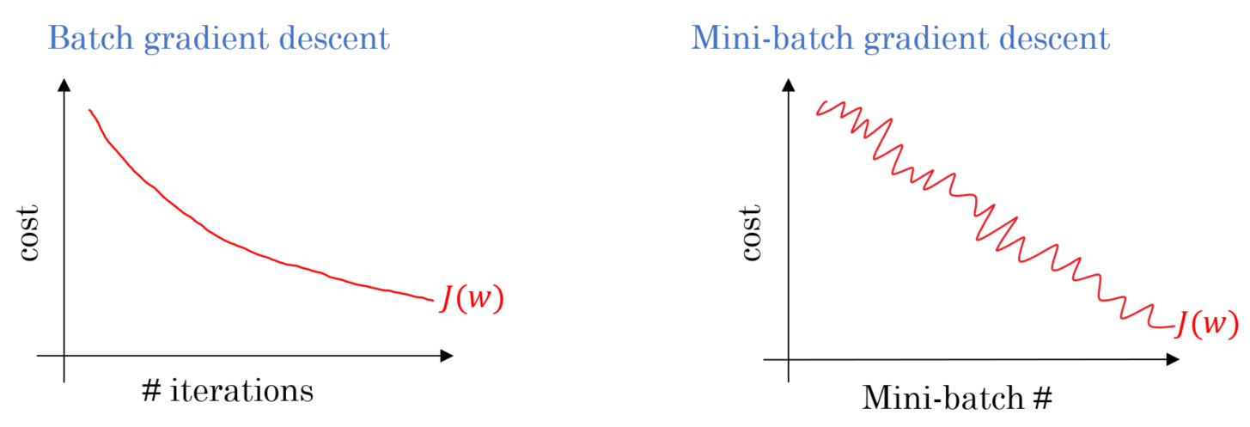
Cost minimization

Slide 5
Typical mini-batch sizes - 32, 64, 128, 256 and 512.
The batch size should fit in the CPU/GPU memory. This depends on the type of data.

Slide 6
Exponentially weighted Moving Averages
A moving average (rolling or running average) is a calculation to analyze data points by creating a series of averages of different subsets of the full dataset.
Taking the average value of a distribution gives a standard value with low noise.
A weighted average is an average that has multiplying factors to give different weights to data at different positions in the subset.

Slide 7
Momentum
The idea is to compute an exponentially weighted average of the gradients, and use that gradients to update the parameters.
The way we update parameters remain the same, but we are not using gradients directly instead we are using the running averages of the gradients.

Slide 8
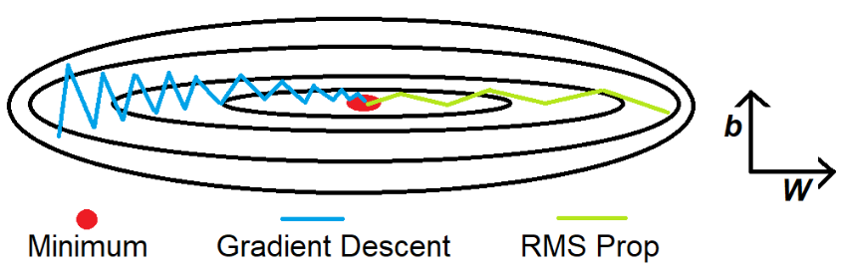
Root Mean Square Prop (RMSProp)
The goal is to speed up the learning in horizontal direction and slow down the learning in vertical direction.

Slide 9
The RMSprop optimizer restricts the oscillations in the vertical direction. Therefore, we can increase our learning rate and our algorithm could take larger steps in the horizontal direction converging faster.

Slide 10
Adam optimizer
Adam optimizer combines the effect of Momentum ( smoothens the gradient step) and RMSProp ( Slows down the learning in vertical direction and speeds up the learning in horizontal direction)
Adam - Adaptive moment estimation.

Slide 11
Learning rate decay
This is a techniques of slowly reducing the learning rate as our model trains.
This allows for the adaptive control of learning rate during the training process.
PyTorch provides learning rate schedulers to achieve this.

